Slide 1
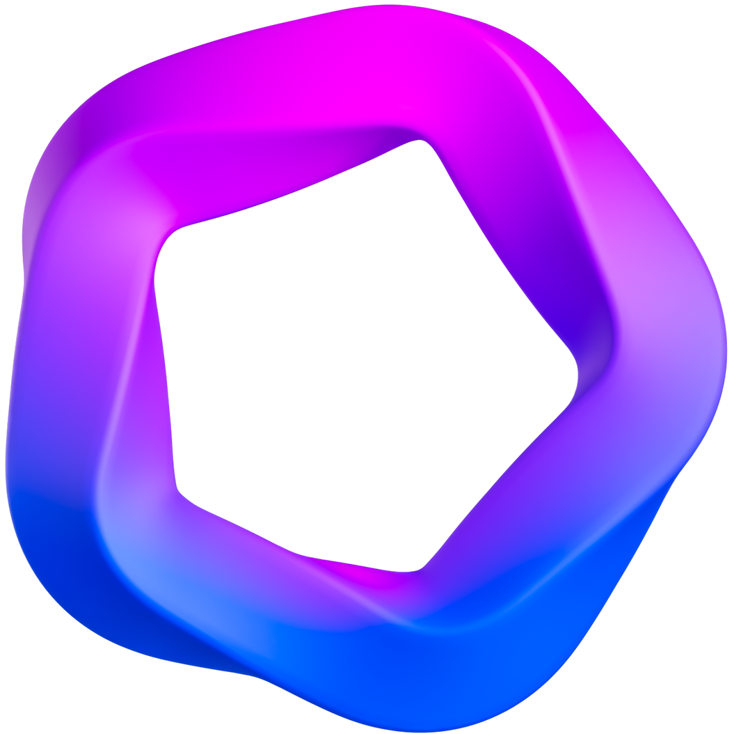
DEVELOPMENT PHASE
REACT APP: ARTSHOP
GitHub Link: https://github.com/molllol/artshop.git
Done by Palmy Guveya.

Slide 2
What does this Web App do?
What is it?
Web application that functions as an online art emporium, providing a simpler and efficient platform for the quick purchase of a diverse selection of unique artworks curated specifically for art enthusiasts.
What does it do?
To deliver a streamlined shopping encounter characterized by efficiency, incorporating key features such as a functional shopping cart and seamless checkout process.
Functioning as a demonstration illustrating the utilization of the MERN Stack in the development of a website.

Slide 3
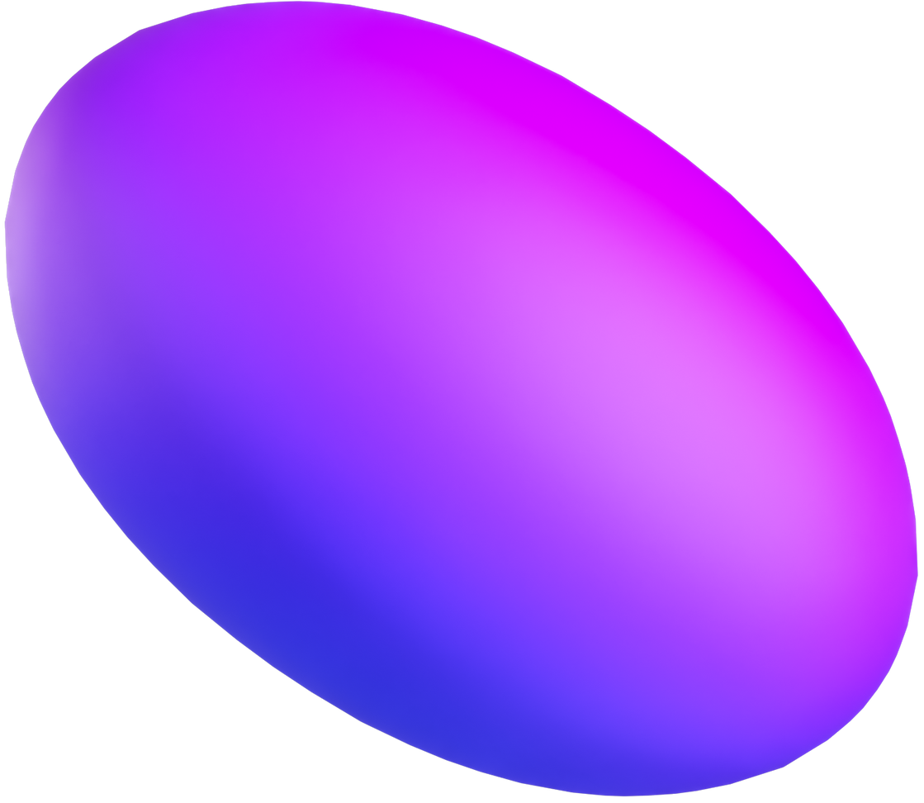
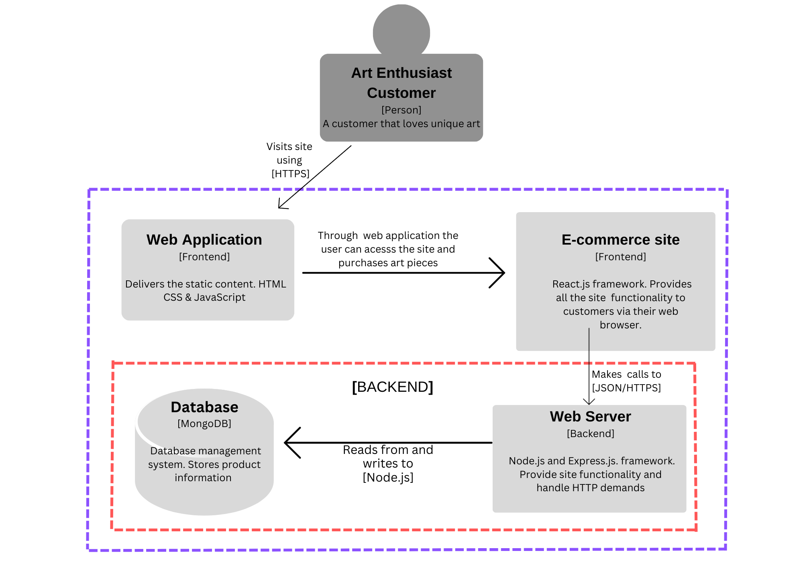
Architecture Diagram

Slide 4




Technology Choices
MERN Stack
REACT.JS
EXPRESS.JS
NODE.JS
MONGODB
Client-side (Frontend)
This JavaScript library is being used to build the user interfaces (UIs) for the web applications.
Includes, JavaScript(JS), CSS and HTML.
This manages the UI, display product info and handle the cart
Server (Backend)
A web framework for server and route management, supporting HTTP request methods.
It manages server-side functions such as order processing, bridging the gap between frontend and backend.
Linked with Mongoose for REST API creation.
Server (Backend)
Open source server environment, where express runs.
What helps express connect to react and allow express to access the database.
Also part of the bridging gap between frontend and backend.
Database (Backend)
A NoSQL database system compatible with Node, React, and Express.
MongoDB stores data in BSON format, aligning seamlessly with JSON for easy integration in a Node.js environment.
This is where processed data, such as product information is stored and can be retrieved.
MERN - Mongo, Express, React and Node

Slide 5
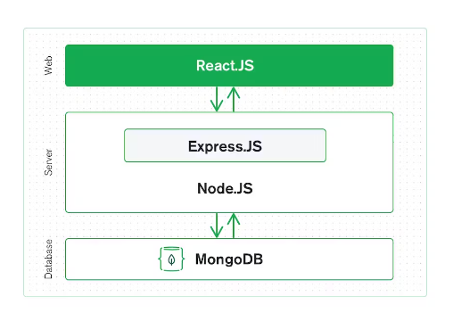
MERN Stack
Image from mongodb.com/mern-stack
An overview of how parts in a MERN Stack communicates and is setup.

Slide 6
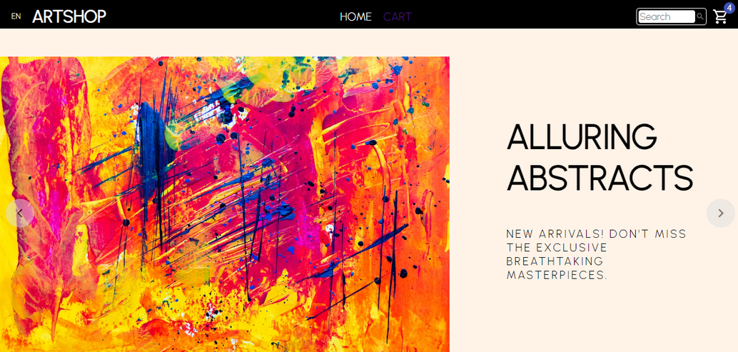
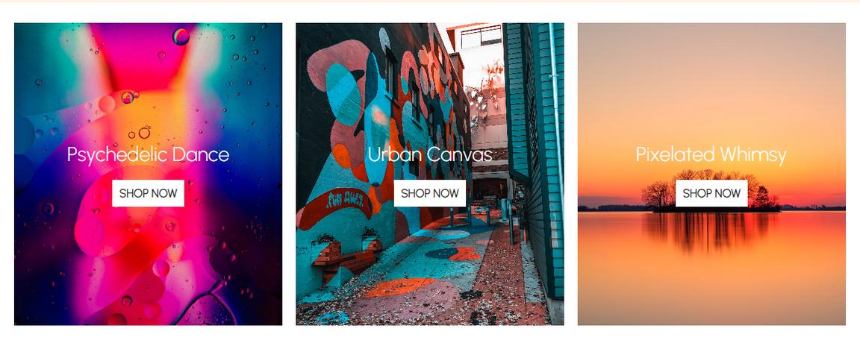
Web App Development
What has been done so far?
Top Image: Homepage with a navigation bar that includes options for search, cart and page links. Below that is a slider that displays various types or forms of art. Giving an idea of what to expect and what is popular.
Bottom Image: This is still on the homepage, for convenient navigation. You can explore distinct art pieces by accessing the main categories that direct you to the 'shop' section.

Slide 7
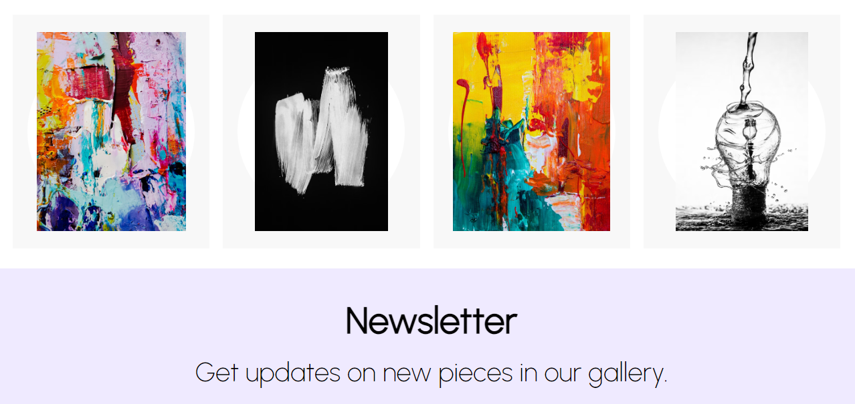
Web App Development
What has been done so far?
Additionally, there is a segment displaying products that, upon selection, directly navigates to the respective product page.
All of these were made with the help of components. On the homepage, there is a component for each section. For example, products.jsx is the products component that contains the code and style for that section.

Slide 8
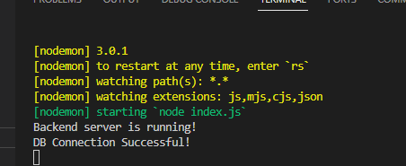
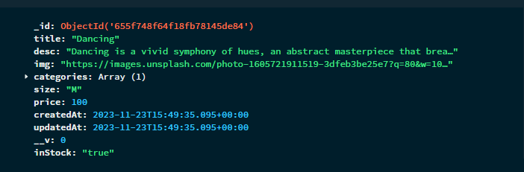
Web App Development
What has been done so far?
Top Image: This is in Visual Studio Code (an IDE). It is showing when the database and server were first connected and whether they were operational.
Bottom Image: I examined MongoDB to verify the successful upload of data to the database. The data creation and posting were performed using Postman.

Slide 9
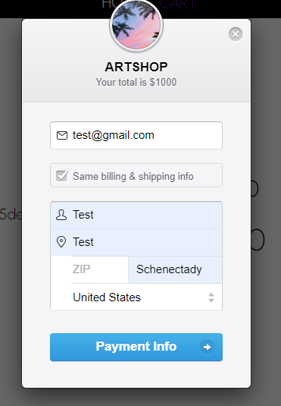
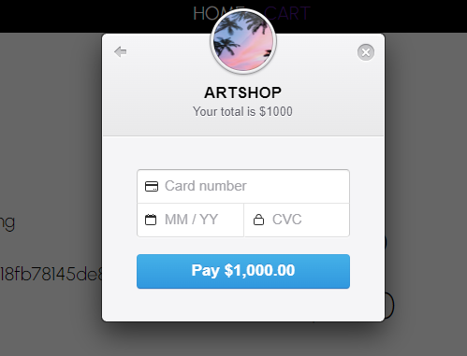
Web App Development
What has been done so far?
To separate code for each part of the backend, different routes and models were created. For example, a stripe route and a cart route.
These two images depict the response made in the cart when one checkouts and has to enter the shipping address and make payment using Stripe.

Slide 10
Test Cases and Data
Action | Expected Result
Run ‘npm start’ in artshop folder in command line to run server | ‘webpack compiled successfully’ in command line
Run ‘npm start’ in shop-api folder in command line to connect to database | ‘Backend server is running’ ‘DB Connection Successful’ in command line
Interact with slide control on homepage | The display changes and switches to next slide
Interact with page links on navbar | Lead to the page selected, e.g. home link lead to homepage
Click ‘SHOP NOW’ button | Lead to products under that category
Click ‘search icon’ on products | Lead to product page
Click ‘plus or minus icons’ in product page | To increase or decrease the number of the product
Click ‘ADD TO CART’ button | A number showing numbers of items added to cart
Click ‘CHECKOUT NOW’ button | Payment window pops up for billing and shipping info
Attempt to submit a blank text in the pop up window | Ensure the system does not accept the submission and prompts the user to enter text
Attempt to enter invalid card number | Ensure the system does not accept the submission and prompts the user to enter valid card details
Enter valid payment details | A green tick to show payment approval

Slide 11

What changes were made?
01
From basic CSS to Styled components
The initial plan was to code the style in a CSS style sheet and then link to the other files. However, I used Styled-components. This is a library that allows you to write CSS in JS while creating custom ReactJS components.
Why? : I’m able to include my CSS in the same file as the HTML and JS. Making it easier to detect errors and reuse code.
Changes
02
Site setup
I altered the comprehensive configuration of the application by eliminating certain functionalities, thereby simplifying the interface to achieve a streamlined, clean, and fresh aesthetic. Eliminated user authentication, transforming it into a landing shop.
Why? : Due to challenges encountered in achieving optimal functionality, a decision was made to implement a streamlined shopping experience, adopting the Quick Stop Shop concept. The primary approach involves utilizing a database for storing product information while concurrently showcasing the proficiency of the MERN Stack.

